Slide 1




DIGITAL LITERACY
SKILLS
BASIC USERS

Slide 2

Module 4
Content

Slide 3

4
Unit 4: Programming

Slide 4
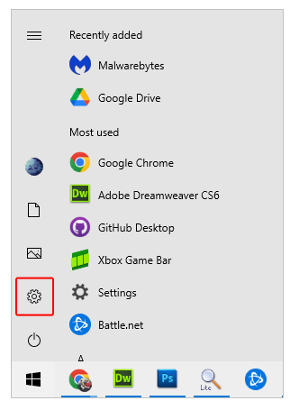
What are default settings?
Default settings refer to the software that is automatically installed on manufactured devices.
All the software has basic default settings so that the device works effectively when purchased.
Default settings can be personalized by the user.

Slide 5
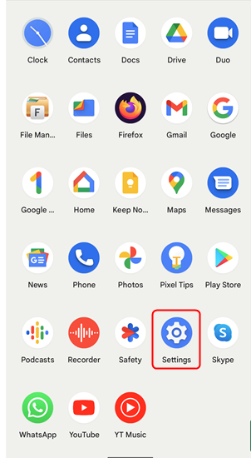
Changing default settings
There is no harm in changing simple default settings, like a ringtone on a smartphone.
Other default settings are more complex and can affect the functioning of the device.
Never change a default setting if you do not know what effect it will have on the device.
The icon to indicate the settings on any device is a cogwheel or gear. Click or tap this icon to access the settings.

Slide 6
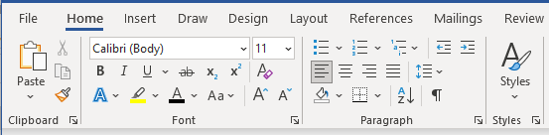
Skills to practise
Modify settings
Open a MS Word document. See the arrow in the bottom right-hand corner of each box. Click on the arrow.

Slide 7
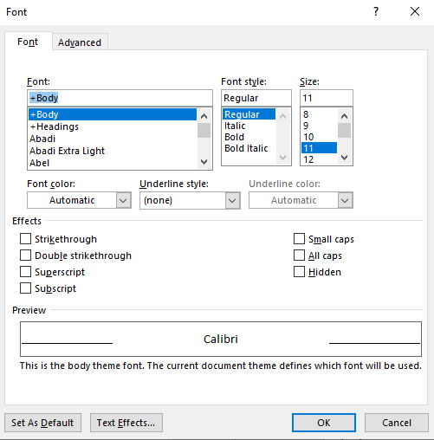
Skills to practise
b) Change the default font style and size to Arial, bold, 14. Then click OK.

Slide 8
All back covers should include
contact information of the section
producing the work.
© United Nations Children’s Fund (UNICEF) [month and year of publication]

